Slide 1


Data Exploration MNIST

Slide 2
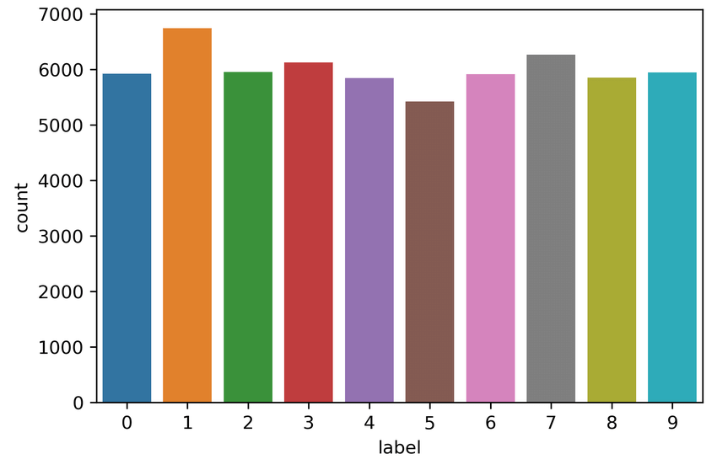
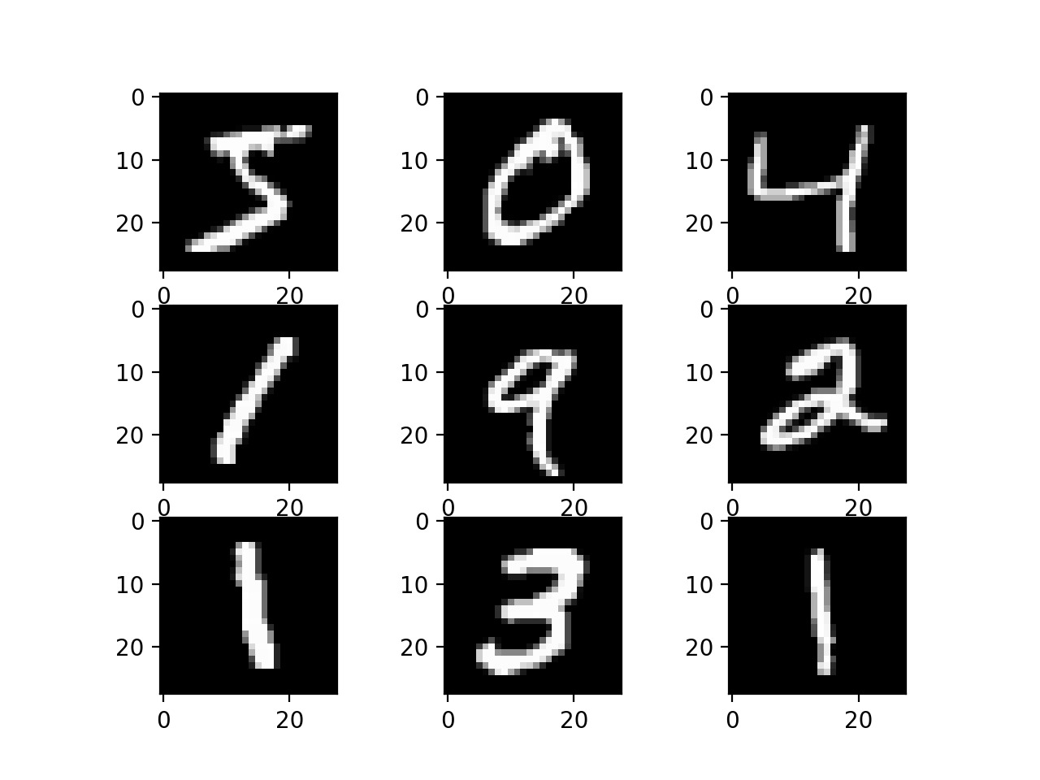
Mnist Visualized
28 x 28 grids of pixels of gray scale values between 0 – 255, mostly composed of zeros
Uniform distribution of digits

Slide 3
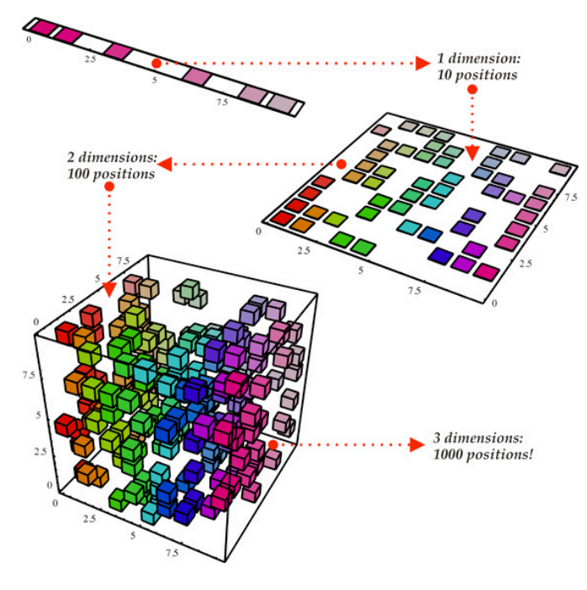
Pre-Processing
Need to reshape data into vectors of length 784
Scale each vector by a factor of 1/255
Possible dimensionality reduction
Dimensionality reduction would reduce compute time
Singular value decomposition (SVD) and principal component analysis (PCA)
PCA works best on sparse matrices, thus better applies to this problem -- most values are 0, white

Slide 4




Possible Models – per Kaggle

Slide 5
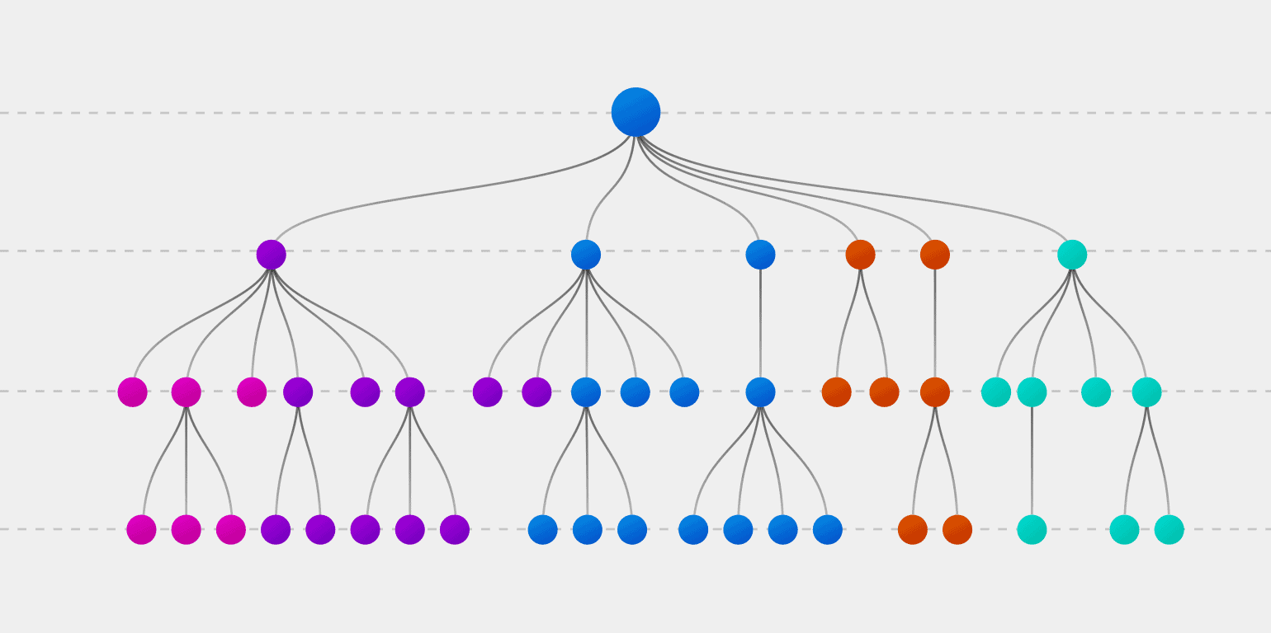
Hyperparameters
Given the various Kaggle results, I will likely try to implement three algorithms – logistic regression, decision tree, and KNN.
Logistic Regression: not any hyperparameter tuning except we need to cross validate results
KNN: we need to cross validate to find optimal k
Decision Tree: we need to find an optimal tree depth and prune the leaves (avoid overfitting). This can be done testing and cross validation.

Slide 6
Metrics of Success
Speed: for actual use in applications, the speed of an algorithm matters. KNN will suffer in this respect.
Accuracy: I will optimize for accuracy
Since the digits are roughly equally distributed, and we only care about recognizing a digit correctly, accuracy will serve as the best metric
We chose accuracy when there is “is no major downside to predicting false negatives”

